Slide 1
FC manages this producer, so can change all product and variant information
Producer: Jammer
Group Buy Unit Size: 6
Product: Jam
BG-1 and BG-2 both have permission to add to Order Cycles AND create Variant Overrides
FC-W offers this
V1: 6 Jars
$36
FC-R sometimes offers this
V2: 1 Jar
$6
BG-1 adds to OC
V2: 1 Jar, FC$6
+10%
FC-R can add to their OC’s if they want
BG-2 adds to OC
V2: 1 Jar, FC$6
+20%
Bulk Order Management and Bulk Coop reports enable calculation by the Group Buy Unit Size amount so that BG’s can see how many they need
IF FC are maintaining produce price from producer and then putting their fee on it, then the BG OC’s will also need to add the FC fee into their OC e.g.
V2: 1 Jar
$6
BG-1 adds to OC
V2: 1 Jar, FC$6
+30%
+10%
+30%

Slide 2
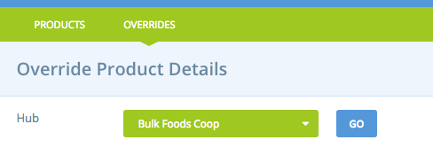
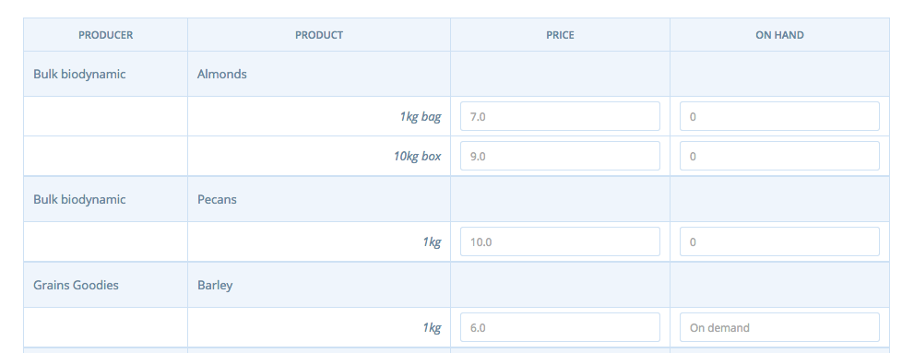
If that doesn’t work for some reason and the BG needs to set a different base price (or stock level e.g. for unallocated), then the BG should use VARIANT OVERRIDES to manage ‘their’ version of the variant
If VO exists for this Hub, will reads from VO rather than underlying product/variant info
FC-R sometimes offers this
V2: 1 Jar
$6
BG-1 adds to OC
V2: 1 Jar, BG-1 $7; on hand:20
+10%
FC-R can add to their OC’s if they want
BG-2 adds to OC
V2: 1 Jar, FC$6
+20%

